Slide 1
Constructing the AMYOTROPHIC LATERAL SCLEROSIS (ALS) Knowledge Graph
An Innovative Approach to Biomedical Knowledge Representation

Slide 2

Introduction
Amyotrophic Lateral Sclerosis (ALS) is recognized as a serious health problem. It is a kind of neurodegenerative illness that becomes worse over time and for which there is presently no known treatment. Since ALS is so complicated and little understood, medical research and healthcare programs have made it a major priority.
ALS, is particularly difficult to understand and treat, as it is influenced by a mix of genetic, environmental, and lifestyle factors, and leads to the loss of muscle control.
Even though there's been a lot of medical research, we still don't understand ALS very well, and we don't have good treatments for it yet.

Slide 3
Overview of the problem:
The complexity of ALS arises from its unknown cause, variable progression among patients, and the current lack of effective long-term treatments.
Since each patient's experience with the disease can vary greatly, it is challenging to anticipate and treat, which makes studying ALS a challenging task.
We realize that earlier studies may have less relevance now that medical technology and our understanding of the condition have advanced, but we concentrate on the last ten years of study (2013–2023).

Slide 4
Methodology
Corpus Selection
Entity Extraction
Entity Merging
Relationship Extraction
Building Knowledge graph

Slide 5
Corpus selection:
We created a Python script to automatically gather ALS research papers from PubMed, focusing on publications from 2013 to 2023.
We collected crucial information from each paper: the title, abstract, and the unique PubMed ID (PMID).
We designed the script to scan up to five pages of search results on PubMed to ensure a thorough data collection.
We organized the data into a structured DataFrame using the pandas library, setting the stage for further entity extraction and analysis.

Slide 6
Entity Extraction:
Using PubTator, we were able to recognize and extract important biological concepts from the research articles we had gathered. PubTator facilitates the search for particular types of information in these publications, such as ALS-related genes, diseases, and chemicals related to ALS.
The requests library in Python was utilized to interact with the PubTator API. It sends out a request for the PMID (PubMed Identifier), a special number assigned to each PubMed publication. In response, PubTator provides text data with annotations. Annotations are notes added to the text that identify and provide information about specific biomedical entities mentioned in the article.
After then, the response text is processed by the code. It processes the data line by line using a parsing function. Details on the entities found in the article are included in every line of the PubTator response. The code searches each line for segments that correspond to an entity annotation's format. This covers the kind of entity (such as a gene or illness), where it appears in the text, and the text itself. An entity is located, extracted, and stored. For later examination, the code usually stores this data in an organized format.

Slide 7
Entity Extraction
Programming for Data Retrieval: We extracted lists of biological terms, such as genes and illnesses, from the abstract of each ALS publication by utilizing a Python script to interact with the PubTator API.
Organizing Annotations: After sending batches of PMIDs to PubTator, the script saved the information it received—such as genes and disorders—in a text file for later analysis.
Extracting and Classifying Entities: We ran our program over the text file to identify biomedical entities and their classifications, which we then put to our database.
Improving the Dataset: We were able to gain a deeper understanding of each study by including these categorized biomedical terms with the information from each paper in the dataset. This allowed for more sophisticated analysis of ALS research.

Slide 8
Entity merging
Standardizing Terms: We changed all the biomedical terms to lowercase and removed punctuation for consistency, using a tool called 'spaCy' to simplify words to their basic forms.
Finding Similar Terms: We used special methods (Levenshtein distance and Jaccard similarity) to figure out which terms were actually the same even if they looked a bit different.
Merging Duplicates: By identifying and combining similar terms, we ensured that each idea in our data was represented only once, removing any repeated terms.
Setting up for Relationship Mapping: With the data cleaned and organized, we prepared to map how these terms are related to each other, an important step for building the ALS knowledge graph.

Slide 9
Extracting Relationships
Using Stanza for Connection Analysis: We used a tool called Stanza to understand how different medical terms, like genes or diseases, are connected in ALS research papers.
Identifying Relationships in Sentences: Our process involved analyzing sentences in each paper to find relationships, represented as 'subject', 'relation', and 'object' - like finding who is doing what to whom in a sentence.
Automating with Python: We automated this task for all papers using a Python script that worked through each abstract to find these relationships.
Preparing for Knowledge Graph Construction: With all these connections identified, we're now ready to build a knowledge graph that will visually show how different terms in ALS research are linked, helping us to discover new insights about the disease.

Slide 10
Building Knowledge Graph
Creating a Visual Network: We used Python and a tool called NetworkX to make a graph that shows how different medical terms, like genes or diseases, are linked in ALS research.
Illustrating Relationships: Each connection (or edge) in the graph shows a relationship, like "causes" or "treats," between the terms (or nodes).
Designing for Clarity: We used another tool, Matplotlib, to draw the graph with clear, colored lines and properly sized points to make it easy to understand.
Laying the Foundation: This first graph is a basic visual guide of the connections in ALS research, and it's the starting point for a more detailed knowledge graph we plan to develop later.

Slide 11


Slide 12
Knowledge Graph for one pmid
Focusing on One PMID: After making graphs for many papers, we chose to concentrate on just one to make things clearer because the full set was a bit confusing.
Simplifying for Better Understanding: By looking at the relationships in just one ALS research paper, we could show the connections more clearly.
Improving Our Method: We focused on one PMID to make sure we accurately showed how different medical terms are related without the complexity of a bigger dataset.
Avoiding Overcomplication: This approach helped us avoid the confusion that comes with trying to map out too many connections at once.

Slide 13
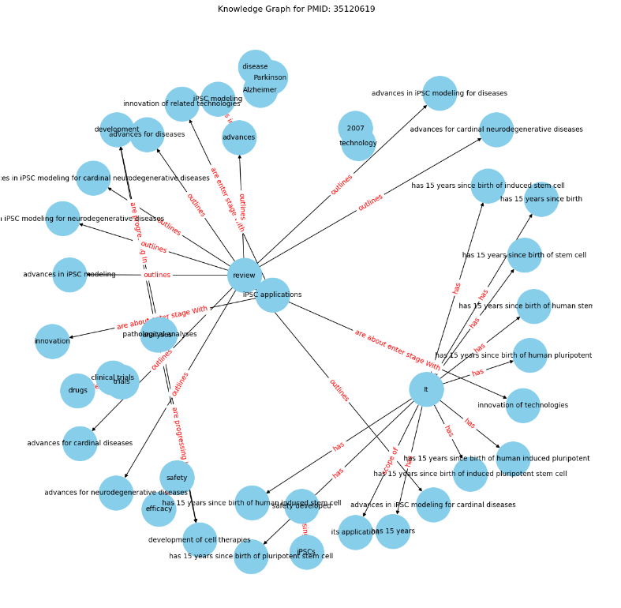

Slide 14
Future work
Enhancing the Knowledge Graph: We plan to make the ALS Knowledge Graph more accurate and useful by checking and improving it using advanced technology.
Using Advanced Language Models: We'll use Large Language Models to better understand ALS research, hoping to find new connections and insights.
Improving Data Analysis Techniques: We aim to refine our methods for pulling out and combining important terms from research papers.
Expanding Research and Usage: Our goal is to grow the ALS Knowledge Graph to include more information and make it a key resource for understanding ALS and related diseases.

Slide 15
Conclusion
We are building a unique ALS Knowledge Graph using modern methods to gather and link information about ALS.
Our approach is designed to be fast and requires less manual work, which helps in expanding the knowledge graph for broader uses.
While focused on ALS, our work also contributes to the overall understanding and fight against other neurodegenerative diseases.
By merging cutting-edge language models and systematic methods, we aim to uncover hidden connections in ALS research, marking a significant step in biomedical studies.

Slide 16
References:
[1] Bean, D. M., Al-Chalabi, A., Dobson, R. J., & Iacoangeli, A. (2020). A knowledge-based machine learning approach to gene prioritisation in amyotrophic lateral sclerosis. Genes, 11(6), 668.
[2] Das, T., Kaur, H., Gour, P., Prasad, K., Lynn, A. M., Prakash, A., & Kumar, V. (2022). Intersection of network medicine and machine learning towards investigating the key biomarkers and pathways underlying amyotrophic lateral sclerosis: a systematic review. Briefings in bioinformatics, 23(6), bbac442.
[3] Hu, J., Lepore, R., Dobson, R. J., Al-Chalabi, A., M. Bean, D., & Iacoangeli, A. (2021). DGLinker: flexible knowledge-graph prediction of disease–gene associations. Nucleic acids research, 49(W1), W153-W161.
[4] A.-M. Tăuţan, B. Ionescu, and E. Santarnecchi, "Artificial intelligence in neurodegenerative diseases: A review of available tools with a focus on machine learning techniques," Artificial Intelligence in Medicine, vol. 117, p. 102081, 2021.
[5] A. Rossanez and J. C. dos Reis, "Generating knowledge graphs from scientific literature of degenerative diseases," in SEPDA@ ISWC, 2019, pp. 12–23.

Slide 17


